Slide 1
NetBorder Call Analyzer
Accuracy Benchmarking
May 2009

Slide 2
How do you make a machine analyze and classify calls?
First things first: the human brain
  Every time we place a call we instinctively perform call-progress analysis
  We listen for dial tone before dialling, detect ring back, busy, answer, background noise, etc.
  Nearly unfailing precision!
How to match this with a machine?
  Algorithms!
  Typical: CPA algorithms implement heuristics on specialized hardware

Slide 3

NetBorder CPA Engine: Unique Approach
Instead of Heuristics, mimic the human brain
We have built a statistical model based on
Neural Networks
  learning machine trained over
  large amounts of data
  High out-of-the box accuracy and confidence measures
  Robust to volume variations and network conditions
  Quick connection (using pre-connect info)
  Streamlined tuning
  Software Platform – no special telephony H/W
  Integrates directly in SIP Networks

Slide 4
NetBorder CPA Performance
Traffic Mix: 50% Human / 50% machine
Accuracy
T=0.9
T=0.95
T=0.8
T=0.85
Data set of > 5000 call recordings
Out of the Box
No Tuning
Mix of:
  Residential
  Businesses
  Mobile
  Music Ring back tone
  Etc.
T=0.75
T=0.7
Accuracy
Gain
Avg. Response Time (msec.)
Speed Gain
T = Confidence Measure Parameter

Slide 5
Graph Explained
5000 recordings sample
  From live deployments
  Blended Businesses, Residential, Mobile calls
Comparison to Dialogic
Set Accuracy with threshold (T) parameter
  With same latency, 15% increase in accuracy
  With ½ latency, 13% increase in accuracy

Slide 6
Graph Explained (cont.)
Dialogic can be tuned to > 90% accuracy
  Limited to very constant call patterns
  (eg. call to residences)
  Changing conditions require constant tuning
NetBorder does not really need tuning, it has been trained to recognize varied set of network conditions
  Expect similar performance with other campaigns (5000 calls is a large enough statistical sample)
  NetBorder algorithm can be trained with more calls samples (sold as a service from Sangoma)

Slide 7

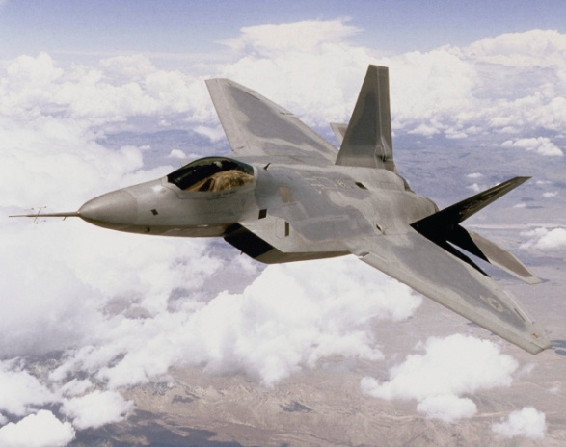
CPA: Why Accuracy and Speed?
Lost productivity
Opportunity costs
Customers have learned that silence in the line may be telemarketers
Regulations

Slide 8

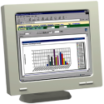

CPA Training / Modeling Process
Outbound Campaign
Annotation
Benchmarking
Training
Productization
NetBorder
Load
Data Set
Recording
and
CDRs
Annotated
Recording
Model
Files
As the data set gets larger, the model learns and gets more robust at handling all situations
Excellent out-of-the-box performance (i.e., without requiring additional training or tuning)
Notes:
Process to train our classifier with new data
Recording: delay hangup
CDR: contains CPA results, connect event, early media information
Script to clean up raw data (identify duplicate, problems, etc.)
Procedure to annotate can be followed by non technical staff
Benchmark: accuracy and speed for various classes. Identify area of improvement
Train with new data sets and maybe new features. Explain training set and test set.
Productization testing: This is sometimes where we discover what the network as learned. For instance: number of rings and correlation to answering machine.

Slide 9
High level Network Architecture
LAN / WAN
LAN / WAN
SIP
SIP
Trunk
SIP
SIP
PSTN
T1/E1
NetBorder Express Gateways
NetBorder
CPA Servers
Asterisk and
Dialer Servers

Slide 10

Thank you!

