Slide 1
Fanvil Product

Slide 2
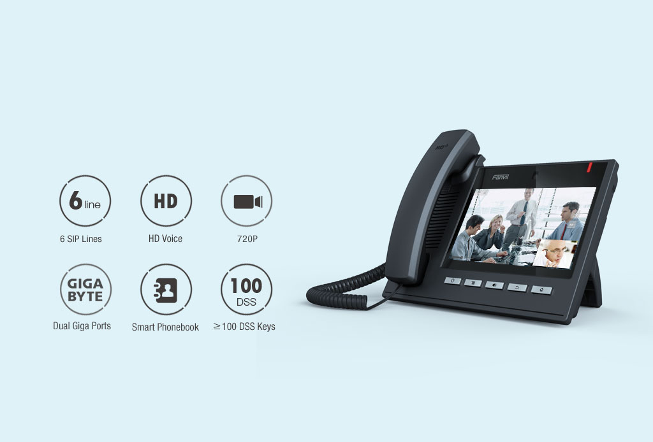
Android Video IP phone
Window to the World via Desktop Terminal

Slide 3

Equipped with 720P HD Video Configuration
Support Three Parties Video Conference

Slide 4
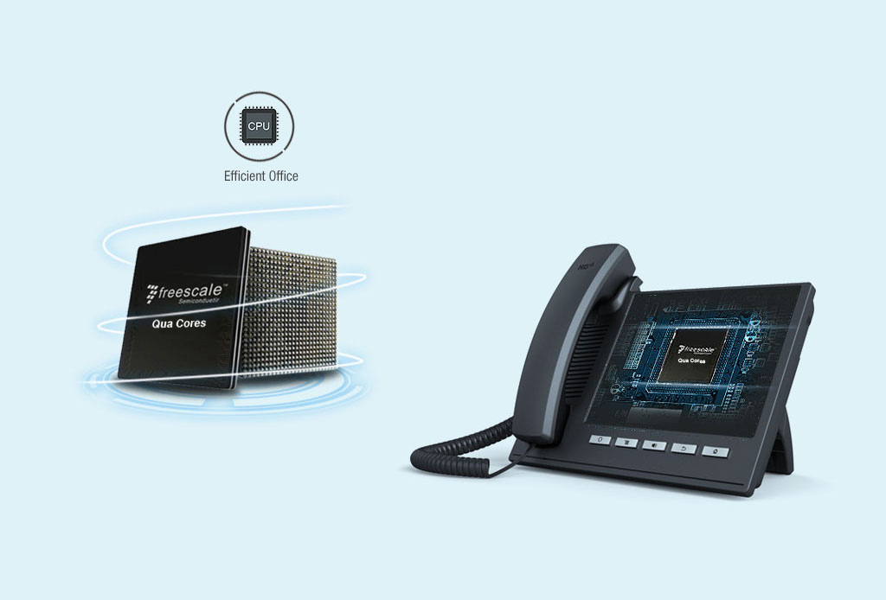
The Best Hardware equipped IP Video Phone
Quad Cores CPU, 1GHz, 1Gb Ram, 4Gb Flash

Slide 5
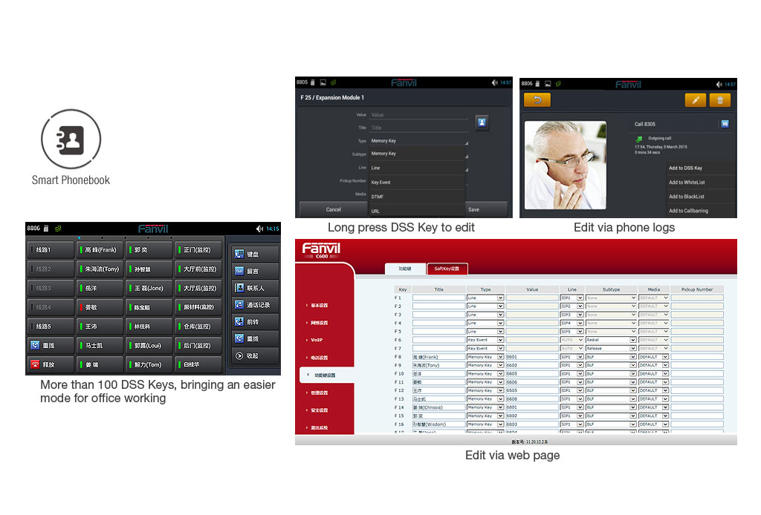
Smart Phonebook
Providing Innovative
User Experience

Slide 6
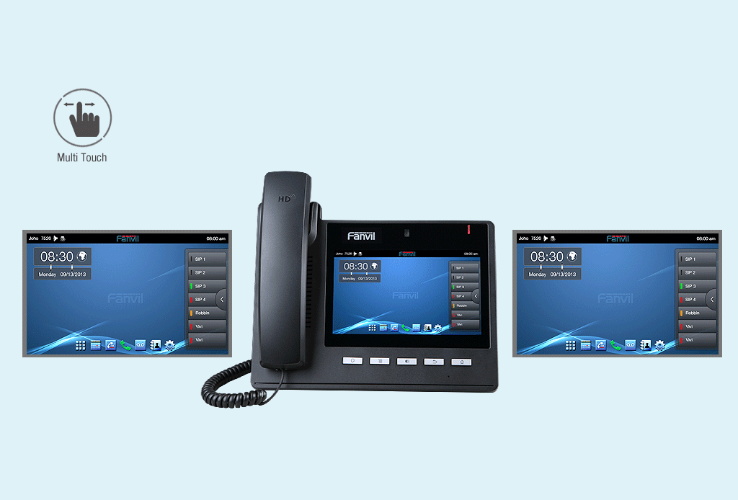
All to Obtain via Touch
Various Gestures to Operate Different Functions
Easy Phone, easy Operation

Slide 7
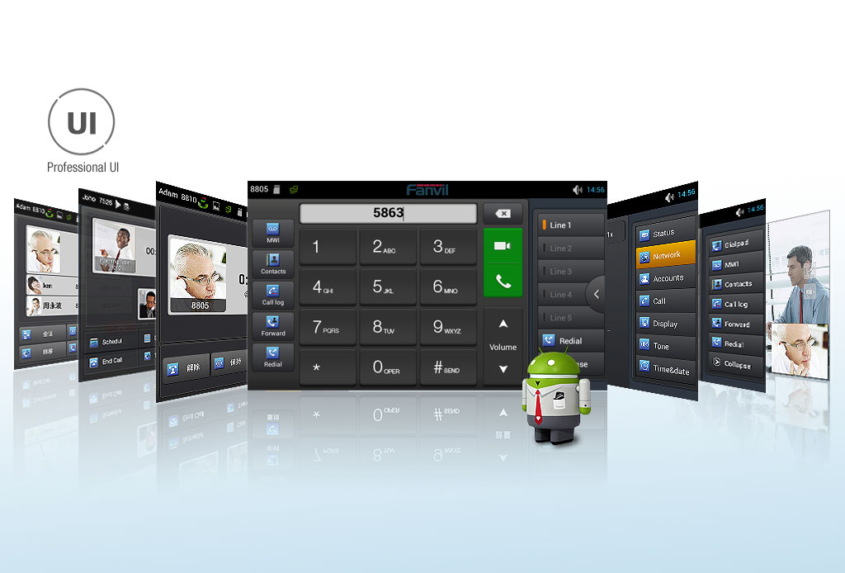
Friendly UI Design to bring better operation experience to you

Slide 8

Dialing via Web, One-button-service,
Taking a Glance at Call Logs, Phonebook and More

Slide 9

Perfect Matching with Various Platforms

