Slide 1
Fanvil Product

Slide 2

i21/i21T SIP Doorphone
Outdoor

Slide 3
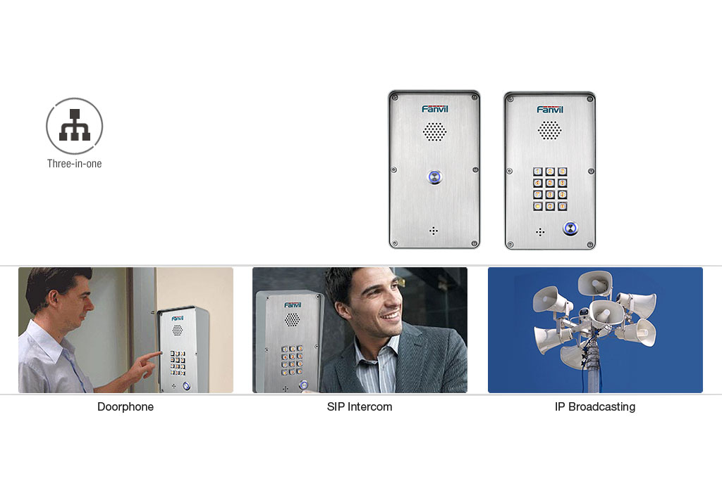
Three-in-one: Doorphone
SIP Intercom and IP Broadcasting

Slide 4

Water-proof, Dust-proof and Striking-proof
Design, Avoiding Malicious Damage

Slide 5

HD Voice, Carrying Background
Noise Cancelling Function

Slide 6
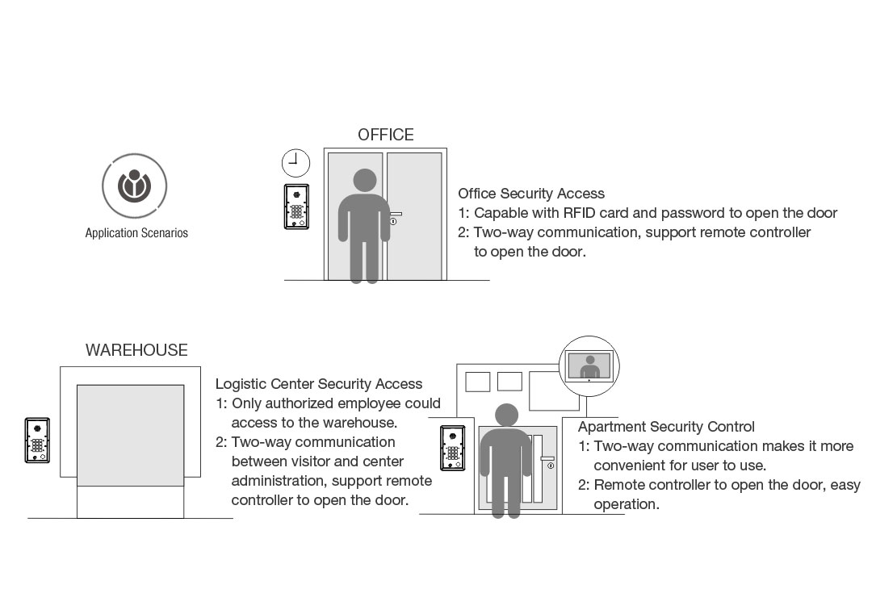

Slide 7
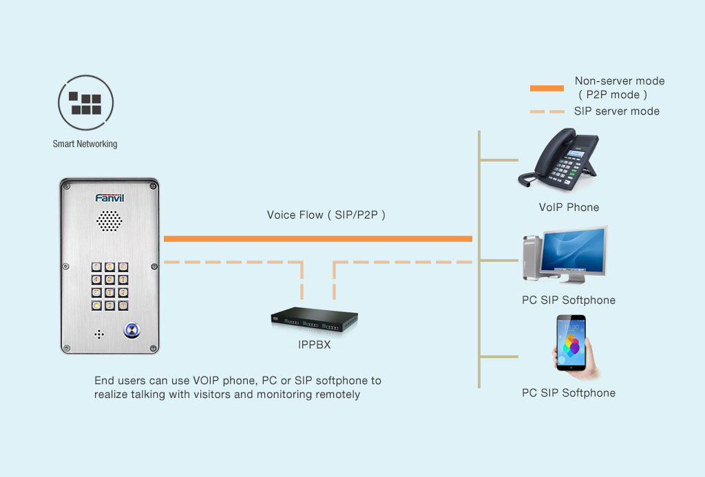
Smart Network Configuration

Slide 8
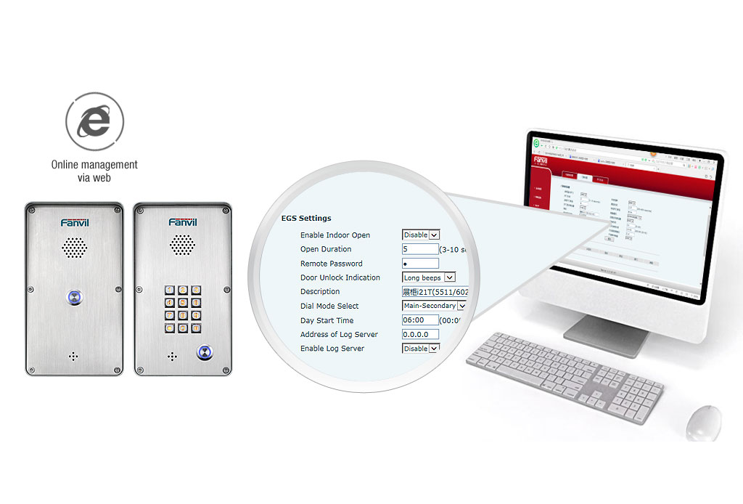
Configure via Web, Easy to Conduct

Slide 9
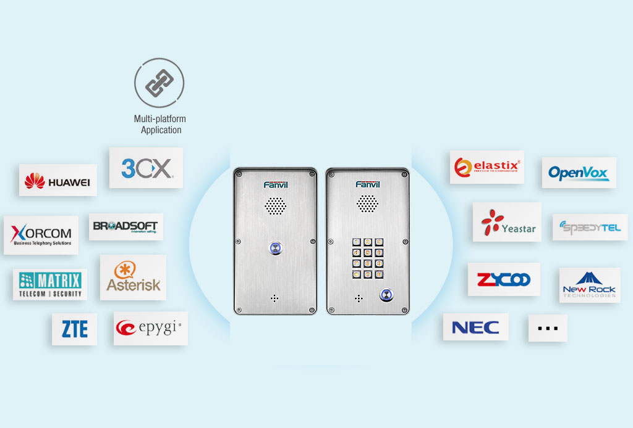
Perfect Matching with Various Platforms

